Slide 1


01
Elementary Java Programming
Java Types and Arithmetic Programs

Slide 2
06
REVIEW OF LECTURES
The 6 Java Numeric Types:
byte
int
short
long
float
double
Other Types:
Char (16 bits unsigned)
Boolean (1 bit)
Recall the Java numeric operators: +,-,/,*,%
How does Java handle integer vs. double division?
How do you get numeric input?

Slide 3


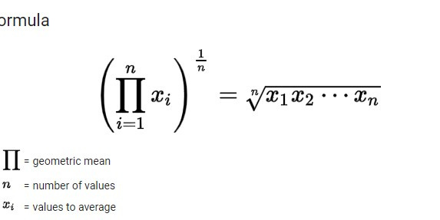
LET'S CODE TOGETHER!
04
We will create a program that computes the geometric mean of three numbers.

Slide 4
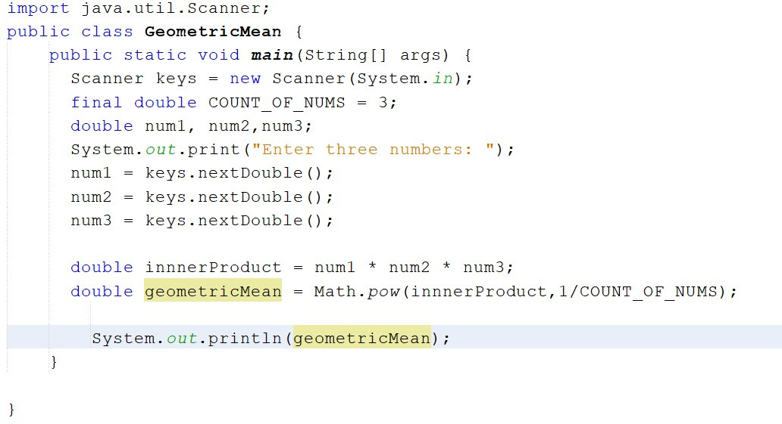

Slide 5



03
Now you code!
Worksheet of problems to be emailed to you.Please let me know if you need help!

